Slide 1

Foundation Bootcamp Telstra
Name: Shubham Bhosale

Slide 2
Day 1-3
How to use lumen
DBMS -MYSQL
NoSQL - MongoDB
SDLC STAGES AGILE METHOD

Slide 3
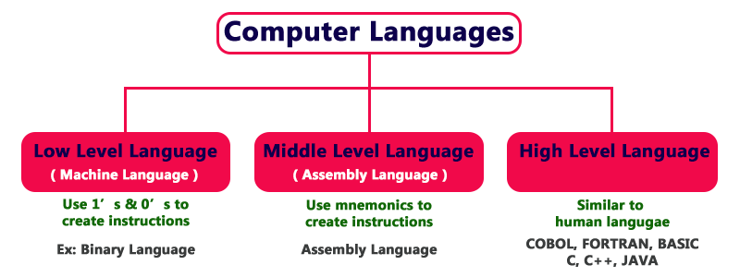
DAY-1

Slide 4
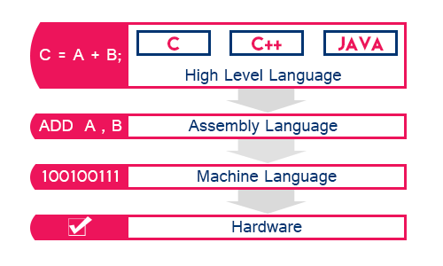

Slide 5
oops
Object means a real-world entity such as a pen, chair, table, computer, watch, etc. Object-Oriented Programming is design software on real world objects.
Solve real world problem
Object
Class
Inheritance
Polymorphism
Abstraction
Encapsulation

Slide 6
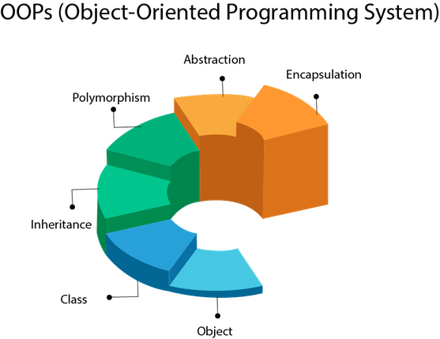

Slide 7
Application Types
Desktop application
Notepad,msoffice
Without internet
Data cannot be changed
Do maintainance(antivirus)
Web Application
Static: content same eg college website
Dynamic: content changes based on users eg. youtube

Slide 8
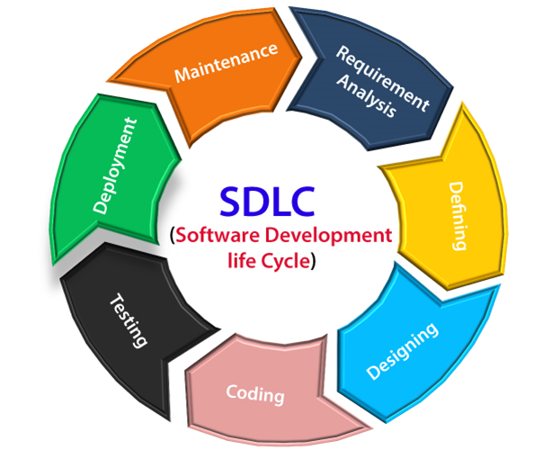
SDLC STAGES

Slide 9
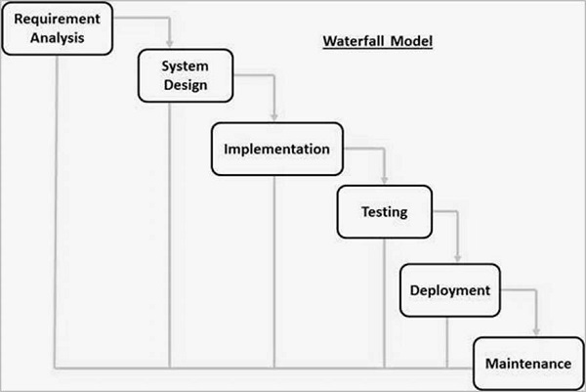
Waterfall Model

Slide 10
Agile Method
Agile product development breaks down the project into short developmental cycles called sprints.
Distributive way to do work
Build in phases
Sprint ->short duration of time
Eg whatsup adding payment feature in existion one

Slide 11
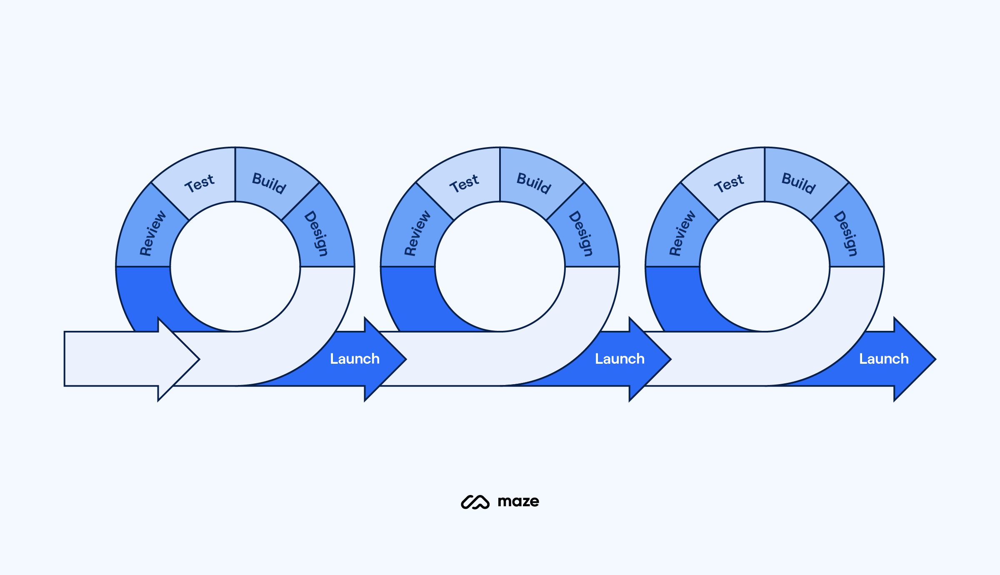

Slide 12
GitHub (Add, commit, pull, push, branching)
1. Create a GitHub Repository: - Create a new repository on GitHub with a name and description. 2. Set Up Git on Your Local Machine: - Install Git and open a terminal or command prompt. 3. Clone the Repository: - Clone the GitHub repository to your local machine using `git clone`. 4. Add and Commit Changes: - Make changes to files in the repository. - Use `git add .` to stage changes and `git commit -m "Your message"` to commit. 5. Pull (Optional): - Use `git pull origin main` to pull changes from the remote repository (if needed).

Slide 13
6. Push to GitHub: - Push your committed changes to GitHub using `git push origin main`. 7. Create and Switch to a Branch (Optional): - Create a new branch using `git checkout -b branch-name`. 8. Merge Changes (Optional): - Create a pull request (PR) on GitHub to merge your branch. 9. Updating Your Local Repository: - Switch to the main branch with `git checkout main` and pull changes with `git pull origin main`. 10. Updating Forked Repositories (Contributing): - Sync your forked repository with the original before making a pull request. These steps cover the essential process of adding, committing, pushing, and branching code on GitHub.

Slide 14
DBMS -Mysql
Data –information
DBMS – storing the data in the system
Database –collection of similar information
RDBMS – records stored in tables
Sql – query Language access data from database.
Mysql- database software

Slide 15
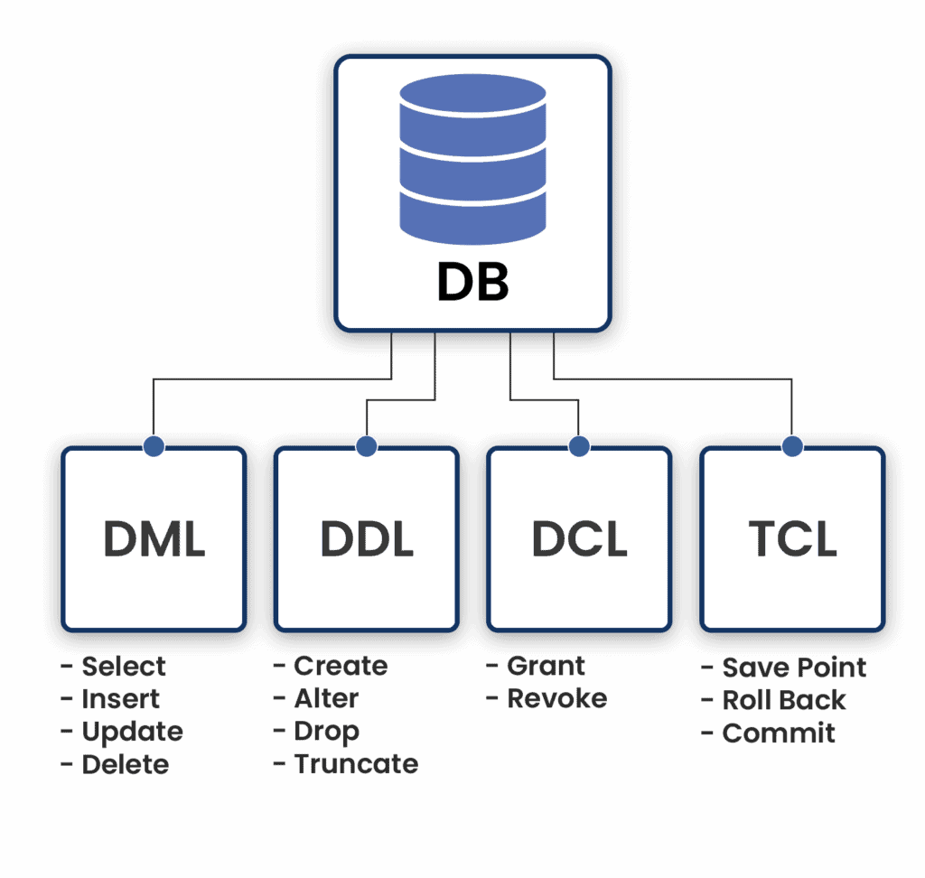

Slide 16
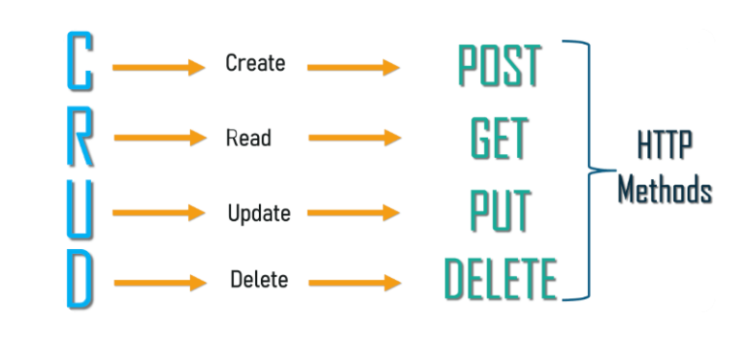
The INSERT statement is used for CREATE:
INSERT INTO <table name> VALUES (field value 1, field value, 2…)
The SELECT statement is used for READ:
SELECT field 1, field 2, …FROM <table name> [WHERE <condition>]
The UPDATE statement is used for UPDATE:
UPDATE <table name> SET field1=value1, field2=value2,… [WHERE <condition>]
The DELETE statement is used for DELETE:
DELETE FROM <table name> [WHERE <condition>]
SQL COMMANDS

Slide 17
NoSql -MongoDb
- is nosql
-unstructured data
-databases –collections
Install mongoshell bin and add it to enviorment variables
MongoDB is an open-source database developed by MongoDB, Inc. MongoDB stores data in JSON-like documents that can vary in structure. It is a popular NoSQL database.
MongoDB is what is called a NoSQL database. This means that pre-defined structure for the incoming data can be defined and adhered to but also, if required different documents in a collection can have different structures. It has a dynamic schema.

Slide 18
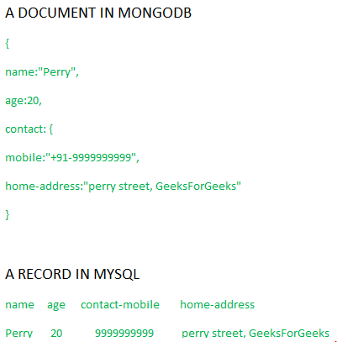
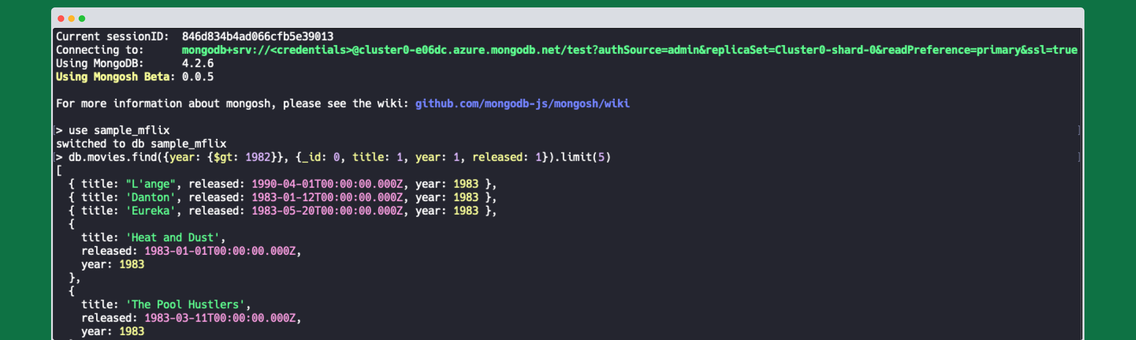

Slide 19
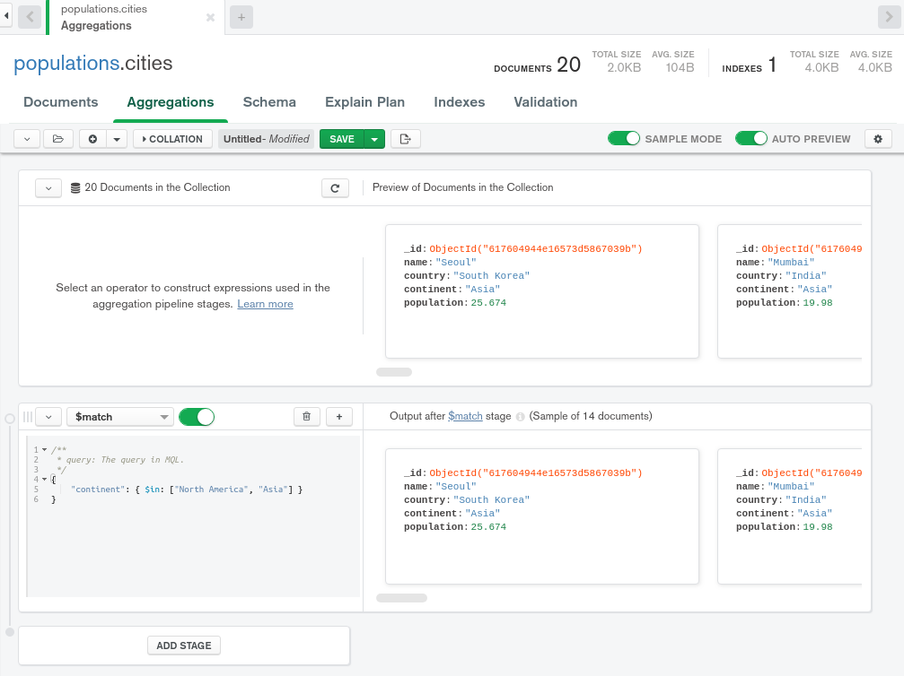

Slide 20
Codes Link to refer
Mysql - https://lnkd.in/g4JnPVTe
Sql -https://www.sqltutorial.org/sql-cheat-sheet/
Postgresql -https://www.postgresqltutorial.com/postgresql-cheat-sheet/
Mongodb -https://gist.github.com/bradtraversy/f407d642bdc3b31681bc7e56d95485b6

Slide 21
Day 4-6
Java oops
JAVA LoMBOK
JAVA MEVAN

Slide 22
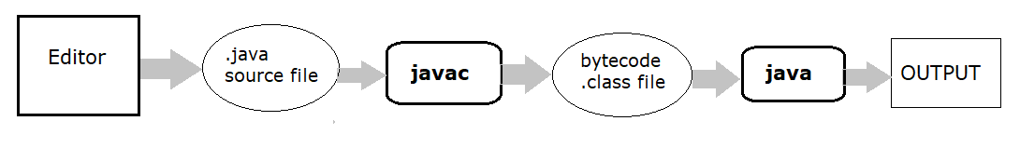
Java compiler

Slide 23
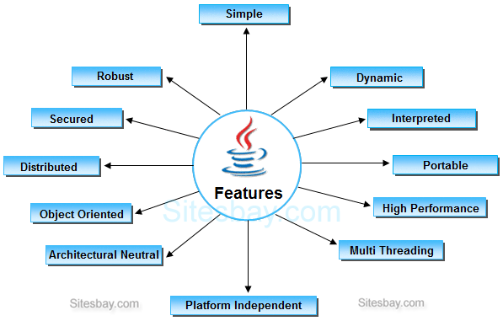
Features

Slide 24
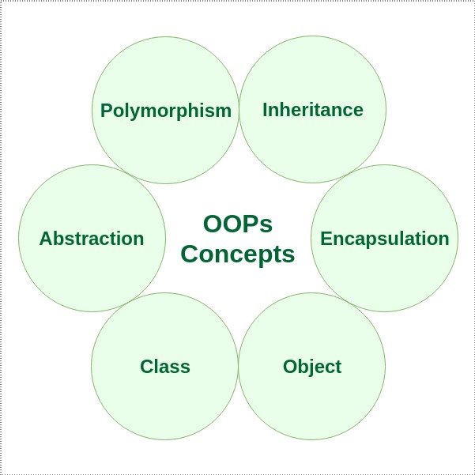

Slide 25
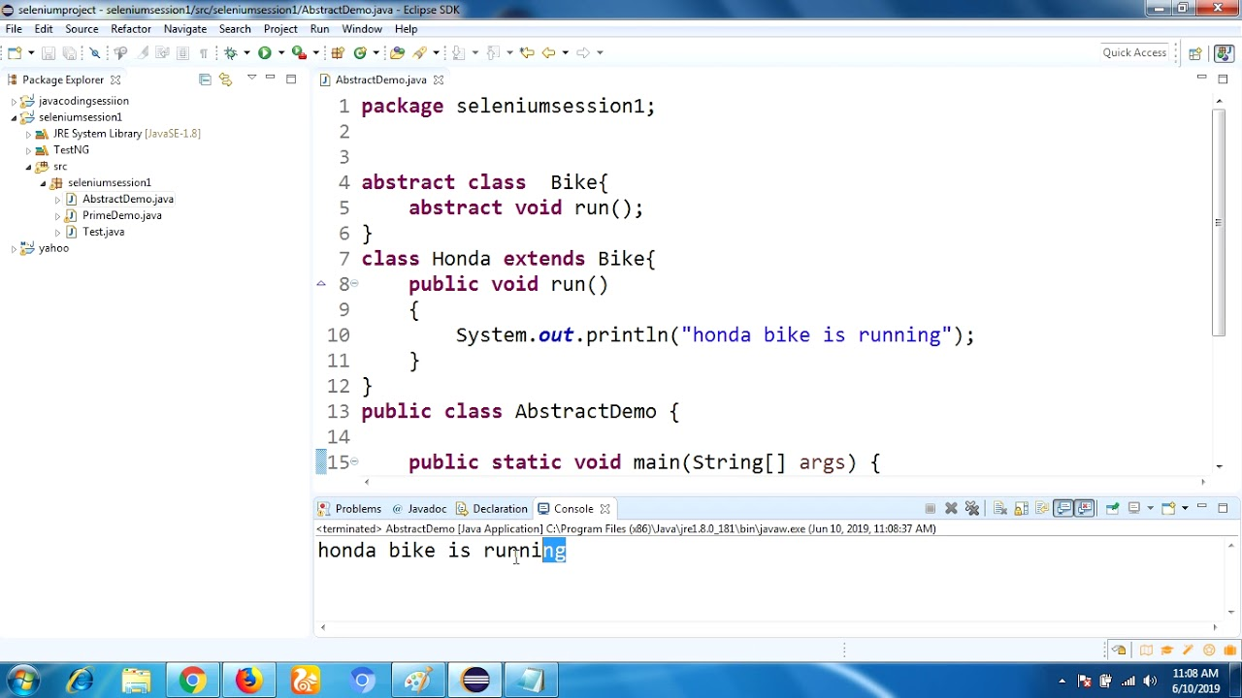
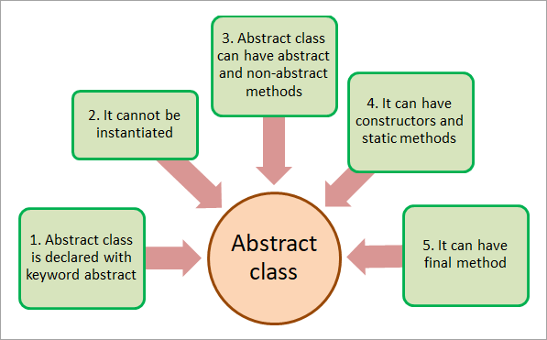

Slide 26
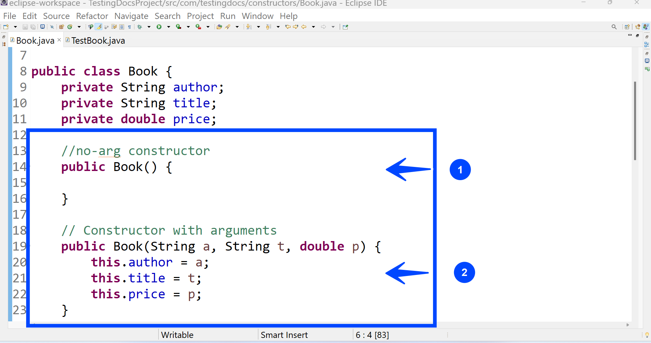
constructor

Slide 27
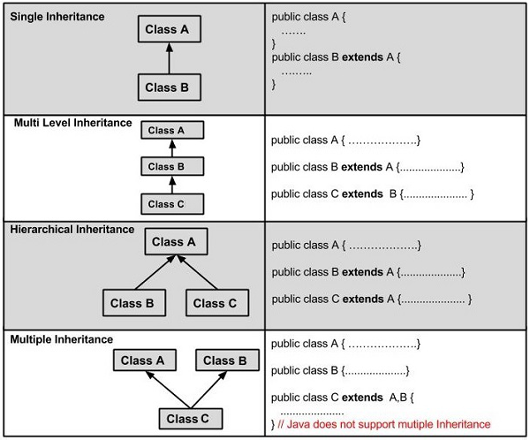
inheritance
Because of ambiguity
We can use super() keyword instead
Or interference

Slide 28
Interface and abstract class
interface A{
void a();//bydefault, public and abstract
void b();
void c();
void d();
}
//Creating abstract class that provides the implementation of one method of A interface
abstract class B implements A{
public void c(){System.out.println("I am C");}
}
//Creating subclass of abstract class, now we need to provide the implementation of rest of the methods
class M extends B{
public void a(){System.out.println("I am a");}
public void b(){System.out.println("I am b");}
public void d(){System.out.println("I am d");}
}
//Creating a test class that calls the methods of A interface
class Test5{
public static void main(String args[]){
A a=new M();
a.a();
a.b();
a.c();
a.d();
}}

Slide 29
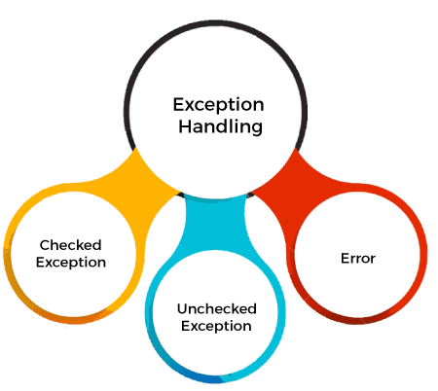
Exception handling
try | The "try" keyword is used to specify a block where we should place an exception code. It means we can't use try block alone. The try block must be followed by either catch or finally.
catch | The "catch" block is used to handle the exception. It must be preceded by try block which means we can't use catch block alone. It can be followed by finally block later.
finally | The "finally" block is used to execute the necessary code of the program. It is executed whether an exception is handled or not.
throw | The "throw" keyword is used to throw an exception.
throws | The "throws" keyword is used to declare exceptions. It specifies that there may occur an exception in the method. It doesn't throw an exception. It is always used with method signature.

Slide 30
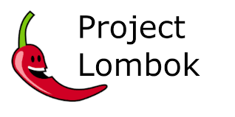
JAVA LoMBOK
Boilerplate code : same/repeated code
Lombok : remove boilerplate code
Like – getter / setter / tostring / constructor

Slide 31
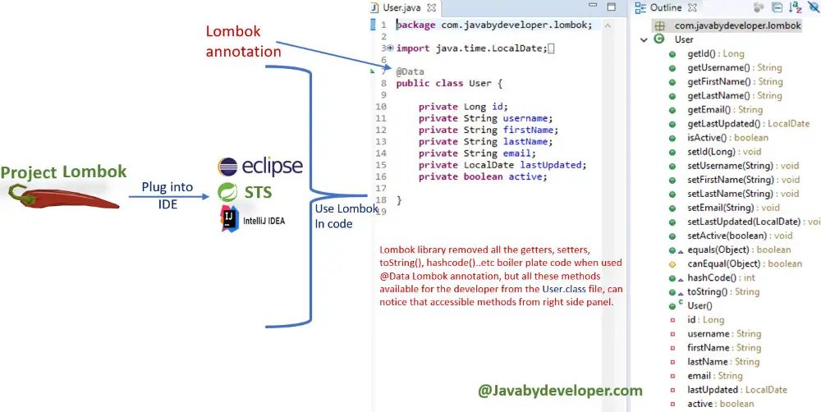

Slide 32
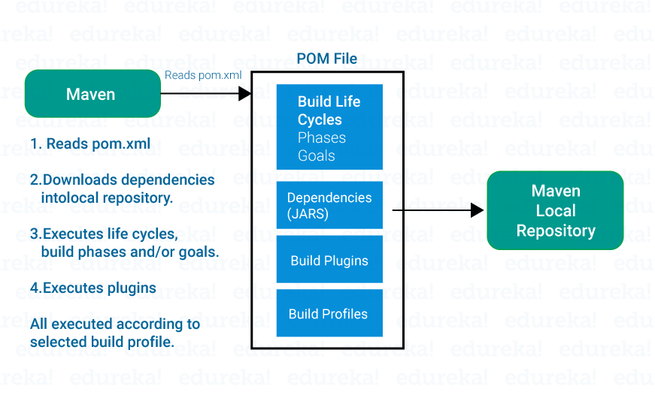
JAVA MAVEN

Slide 33
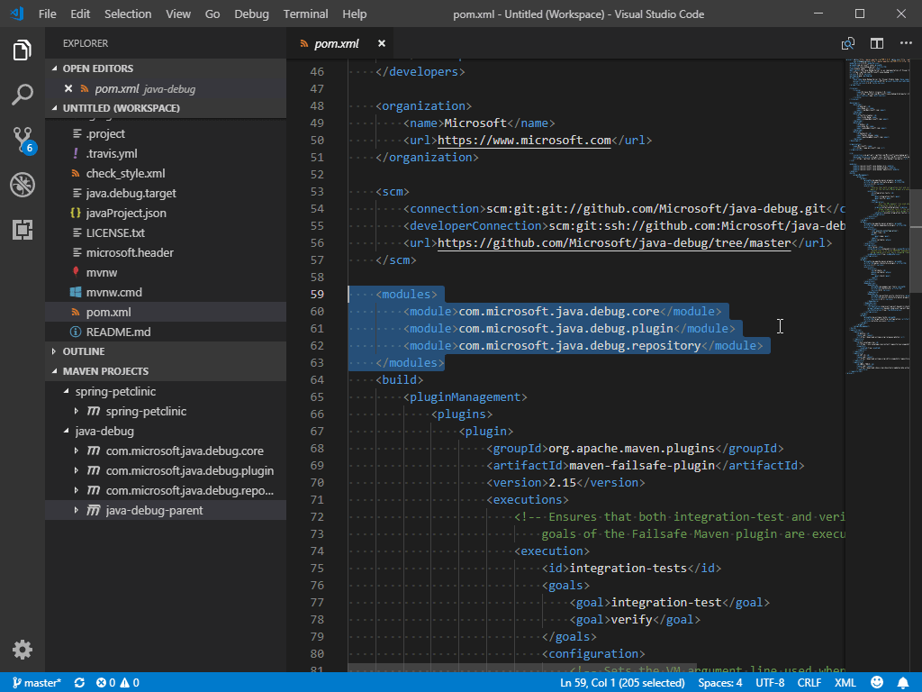

Slide 34
Day 7-9
Java junit
Code quality
Learn cloud

Slide 35
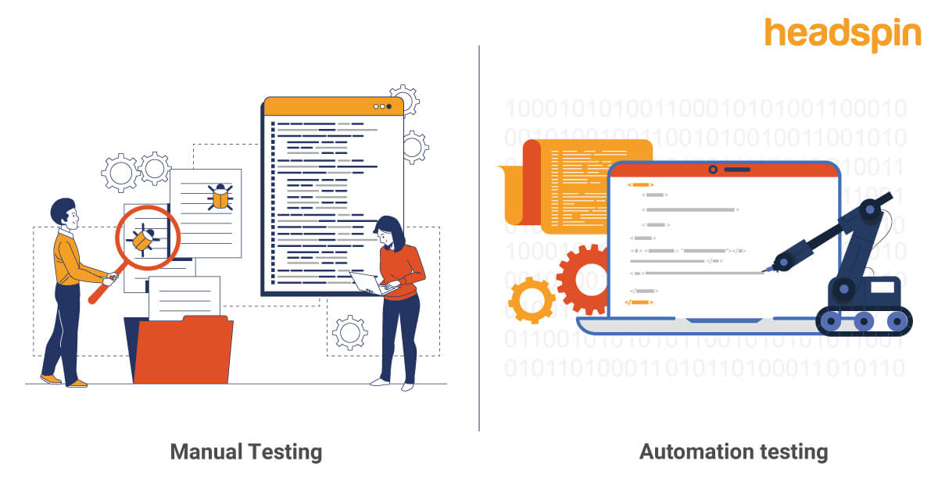
Java junit
It is an open-source testing framework for java programmers.
Unit testing : small testable component of application

Slide 36
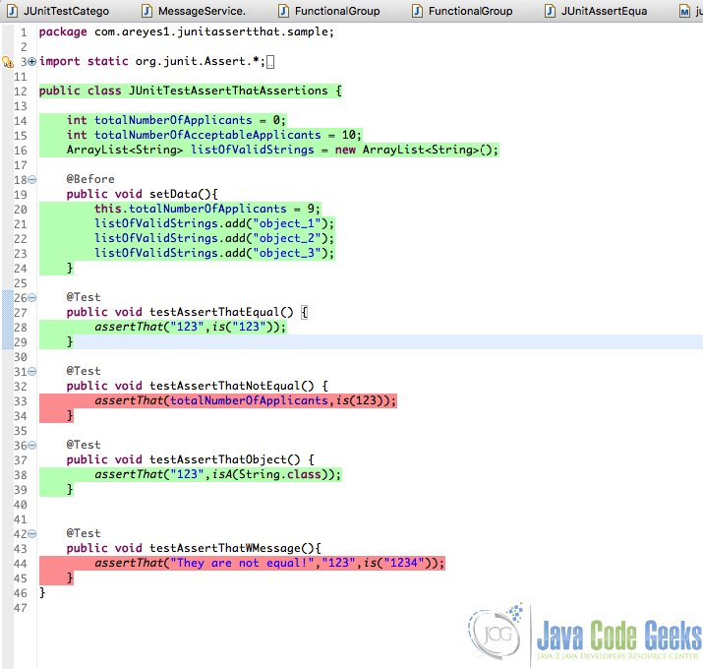


Slide 37
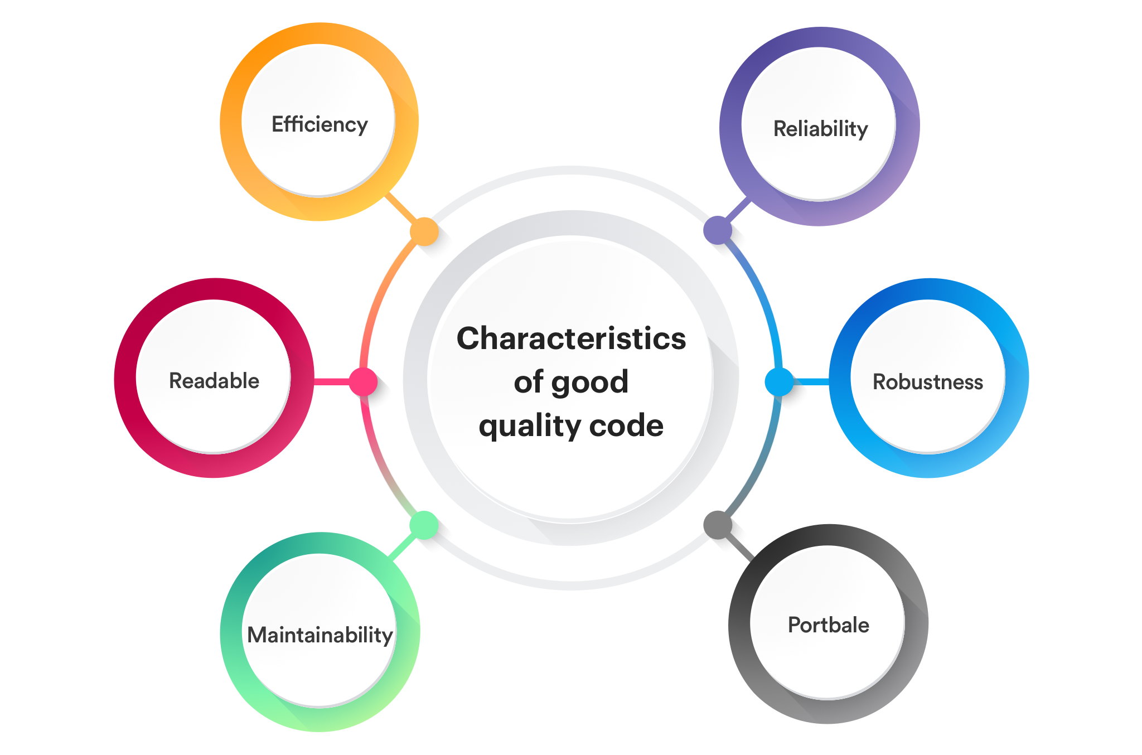
Code quality

Slide 38
Introduction to cloud
Provide resources on demand
Pay as you use
On demand they increase or decrease the resources
It provide resources over the internet
Type –
Private : within organization
Public : globally
Services in cloud:
1.Saas
2.Pass
3.Iaas

Slide 39
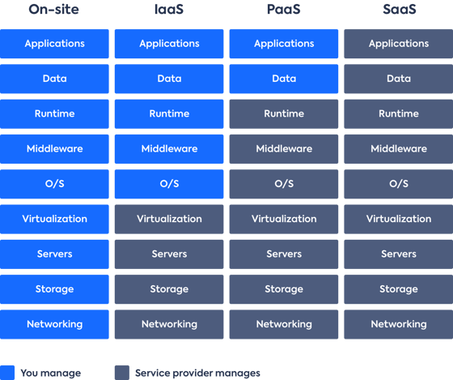

Slide 40
Day 10-13
DevOPS – ci/cd
API Testing
Digitization in Telecom World

Slide 41
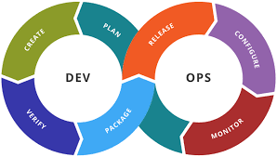
Devops
Plan: Define project goals, requirements, and tasks. Collaborate on design and architecture, creating a clear roadmap for development.
Code: Developers write, review, and test code, using version control systems to manage changes and maintain codebase integrity.
Build: Automated build processes compile, package, and generate deployable artifacts from source code, ensuring consistency and reproducibility.
Test: Automated testing validates code functionality, performance, and security. Continuous testing identifies and rectifies issues early in the development lifecycle.
Integrate: Regularly integrate code changes into a shared repository. Continuous integration detects integration problems promptly, fostering a stable codebase.
Deploy: Automated deployment releases code to various environments, reducing manual errors and ensuring consistency between development and production.
Monitor: Continuous monitoring and logging track application performance, detect anomalies, and provide insights for proactive issue resolution.
Operate: Operate and maintain the application in production. Automated management ensures scalability, availability, and efficient resource utilization.
Feedback: Gather feedback from users and stakeholders to drive improvements and iterate on the development process.
Optimize: Continuously refine processes and tools based on feedback and performance data, aiming for efficient and reliable software delivery.

Slide 42
Docker commands
Docker container: runtime environment used for shipping the application
Docker file: set of instruction
Docker image :ready to use software(template)
Docker Client : interact with docker
Docker host : server used to run container
Docker hub : world largest library and community for container images.

Slide 43
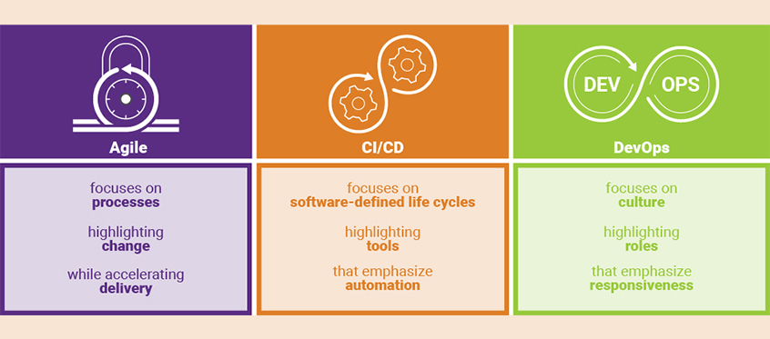

Slide 44
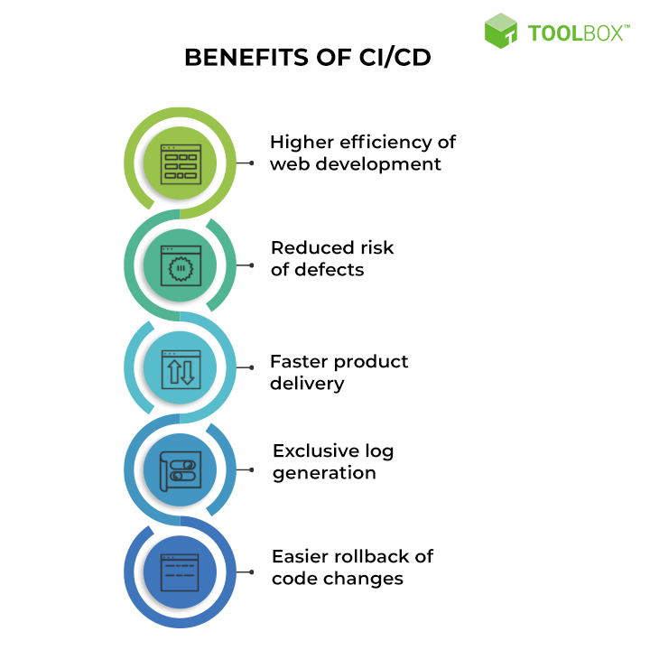


Slide 45
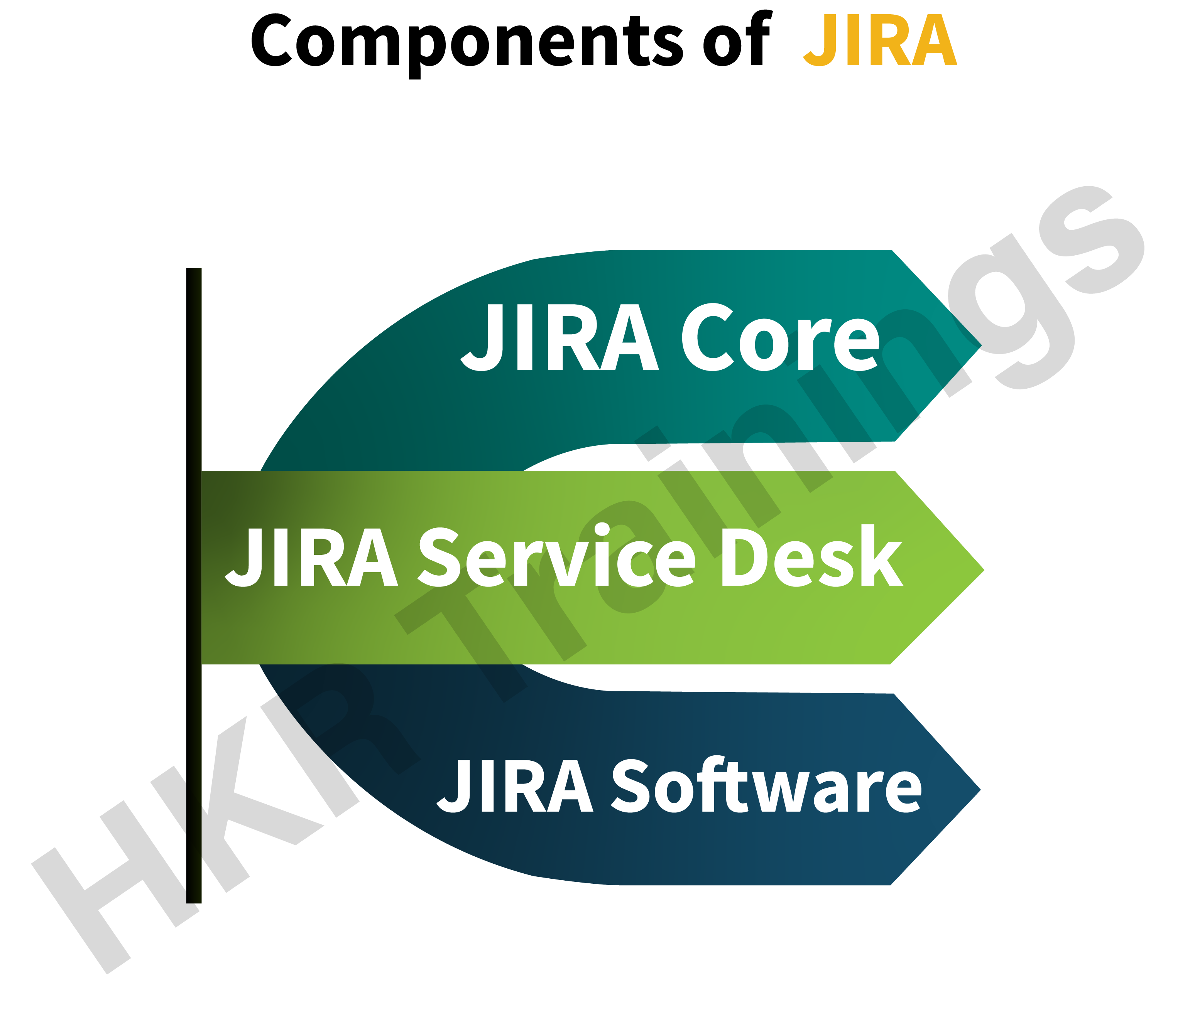
Jira
The JIRA platform is currently offered in three variations;
JIRA Core – a standard project management platform
JIRA Software – the standard project management platform with additional Agile features and functions
JIRA Service Desk – used primarily by IT professionals or users of service desks

Slide 46


